Slide 1
Basic Theory of Discrete Mathematics
Spring & Summer, 2024
Instructor: Ming Li
State Key Laboratory of CAD&CG
liming@cad.zju.edu.cn
13968066337

Slide 2
离散数学-简介
离散数学是计算机专业课的基础：离散关系、离散结构
研究对象：离散数量关系和离散结构的数学模型及算法
计算机时代：建立离散结构相应的数学模型
离散量：逻辑量、图、树、整数、布尔代数
连续量：体积、温度、压力、电压

Slide 3

离散数学-简介
连续结构在计算机上采用离散表示：
数字、文字、声音、图像、三维结构
声音用离散的高度表示

Slide 4


离散数学-简介
连续结构在计算机上采用离散表示：
数字、文字、声音、图像、三维结构
图片用离散的像素表示

Slide 5
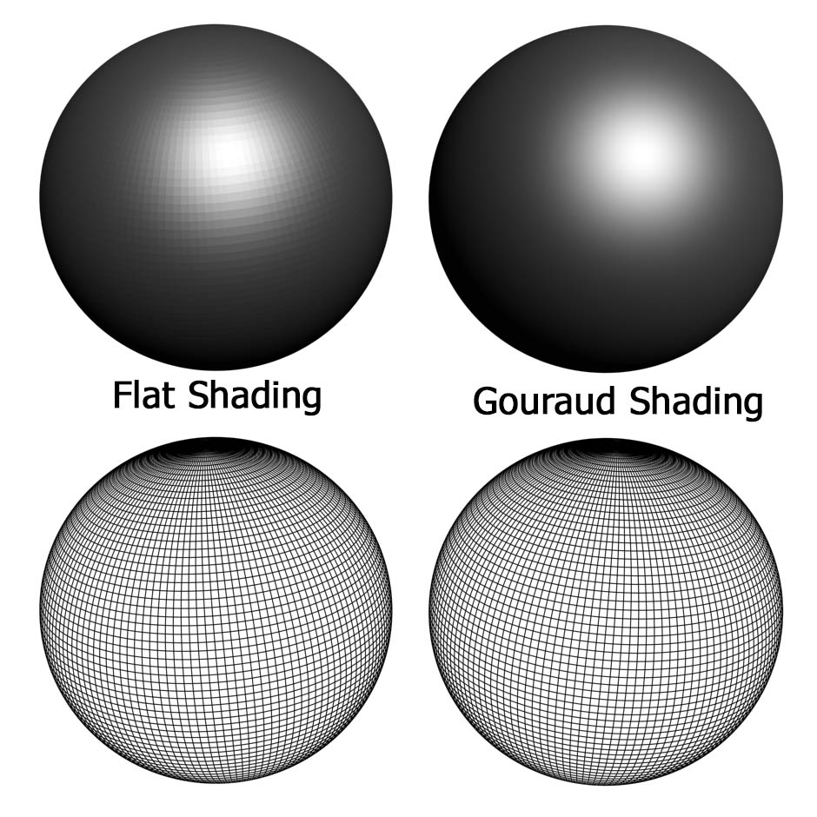

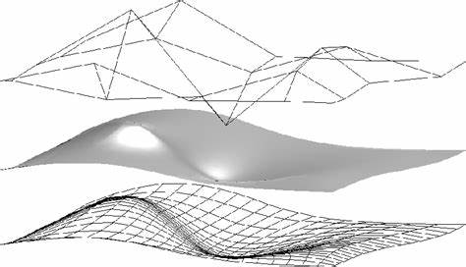
离散数学-简介
连续结构在计算机上采用离散表示：
数字、文字、声音、图像、三维结构
三维几何用离散的三角网格表示

Slide 6
离散数学-简介
离散数学是研究非连续的离散对象的一个数学分支，内容主要包括：
数理逻辑 Mathematical reasoning
命题逻辑、谓词逻辑、集合与关系、函数
组合数学 Combinatorial analysis
归纳与递归、组合计数、初等数论
离散结构 Discrete structures
集合论与图论

Slide 7
参考教材及相关资料
1. Discrete Mathematical and Its Applications (8th Edtion)
Kenneth.Rosen，McGraw Hill，2019
2. 离散数学及其应用，金一庆、张三元、吴江琴、方敏，机械工业出版社，2016
3. 离散数学学习指导与习题解析，耿素云、屈婉玲，高等教育出版社，2005
4. 离散数学 — 常见题型解析及模拟题，傅彦，西北工业大学出版社，2004

Slide 8
成绩构成
平时成绩：50%
1、 课程作业：占10%
2、 Quiz：闭卷，随堂测验形式进行，约4次；
3、 课堂
期末考：50%
闭卷，由教务处统一安排，所有平行班统一命题，统一阅卷

Slide 9
Course Overview
Fundamentals (chapters 1 – 5)
Logic and Proofs (axiom --- reasoning ) (Chapter 1)
Basic structures (sets, functions), algorithms (Chapters 2,3 )
Number Theory and Cryptography (Chapter 4)
Induction and recursion (Chapter 5)
Discrete Structures (chapters 6 – 11, except 7)
Counting (Chapters 6, 8)
Relations (Chapter 9)
Graphs (Chapter 10)
Trees (Chapter 11)

Slide 10
Logic
逻辑是探索、阐述和确立有效推理原则的学科，
最早由古希腊学者亚里士多德创建的。经典的逻辑表述及推理都是用自然语言来实现的。
符号逻辑又称数理逻辑、理论逻辑。
用数学的方法研究逻辑的思想
一般追溯到莱布尼茨，他认为经典的传统逻辑必须改造和发展，使之更为精确和便于演算。
数理逻辑就是精确化、数学化的形式逻辑，它是现代计算机技术的基础。
用数学的方法研究关于推理、证明等问题的学科就叫做数理逻辑

Slide 11
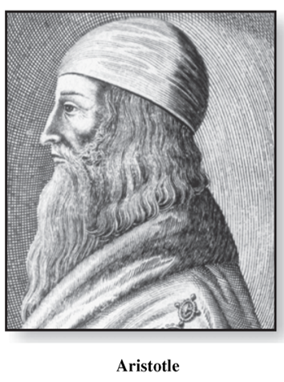
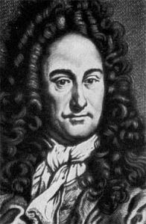
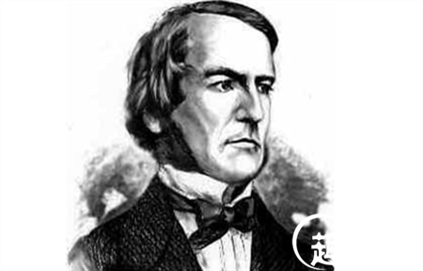
数理逻辑发展史
Gottfried Wilhelm Leibniz
数理逻辑的先驱
Bool
初步奠定了数理逻辑的基础
《逻辑的数学分析》，
建立了“布尔代数”，
创造符号系统，
表示逻辑中的各种概念。
一系列的运算法则，
利用代数的方法研究逻辑问题，
形式逻辑学的奠基人
几何实验
“符号系统”作为
知识的通用的科学语言
莱布尼茨最大的贡献不是发明微积分，
而是发明了微积分中使用的数学符号

Slide 12
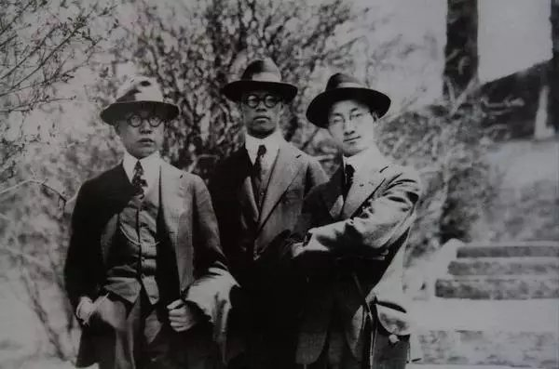
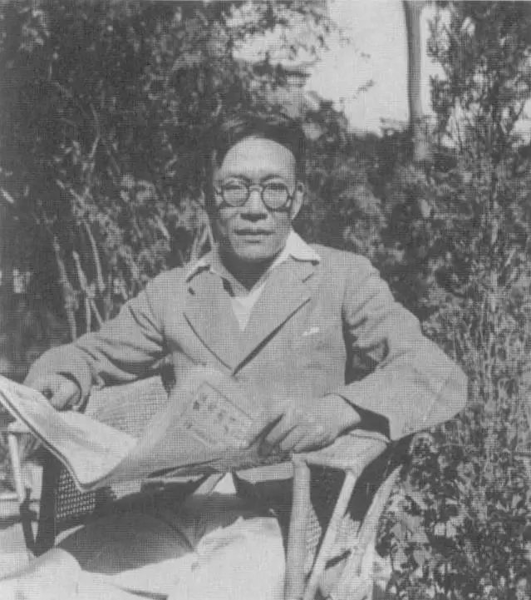
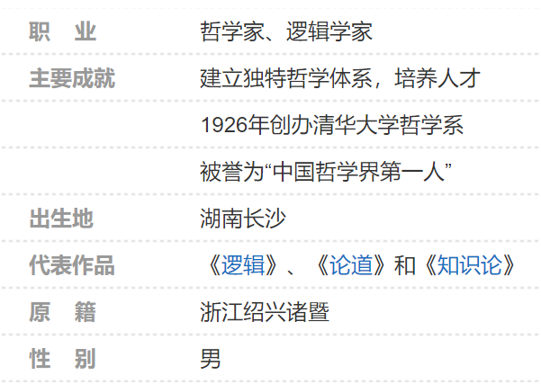
中国的数理逻辑
（左起）金岳霖、张奚若、徐志摩在美国哥伦比亚大学
金岳霖：中国哲学第一人

Slide 13
Chapter Summary
逻辑表示：
现实-符号的对应关系
逻辑运算：
布尔运算、证明/推理
逻辑应用
Propositional（命题） Logic
The Language of Propositions
Applications
Logical Equivalences （等价式）
Predicate（谓词） Logic
The Language of Quantifiers（量词）
Logical Equivalences
Nested Quantifiers
Proofs (证明)
Rules of Inference（推理）
Proof Methods
Proof Strategy

Slide 14
Propositional Logic
Section 1.1

Slide 15
Proposition
【Definition】A proposition is a declarative sentence that is either true or false, but not both.
Examples
Where am I?
Cheer up!
X+1=2
1+1=2
Hangzhou is the capital of China.
x
x
x
√
√

Slide 16
Propositional Logic
Propositional Logic (Calculus): the area of logic that deals with propositions
Propositional variables: small letters such as p, q, r, s …
Truth value: T (true proposition), F (false proposition)
Logical operators (Connectives): be used to form compound propositions from existing propositions
Negation operator ¬ (NOT)
Conjunction operator ∧ (AND) （和取）
Disjunction operator ∨ (OR) （析取）
Exclusive or operator ⊕ (XOR) （异或）
Conditional operator → (IF--THEN)
Biconditional operator ↔ (IF AND ONLY IF)

Slide 17
Negation (NOT)
【Definition】Let p be a proposition. The negation of p, ¬p, is the proposition
“It is not the case that p.”
Example:
p: Today is Tuesday.
¬p: It is not the case that today is Tuesday. (Today is not Tuesday.)
Truth table
p | ¬p
T | F
F | T
The truth value of ¬p is the opposite of the truth value of p
Notes:
非

Slide 18
Conjunction (AND) 和取
【Definition】Let p and q be propositions.
The conjunction of p and q, p ∧ q, is the proposition “p and q.”
Example:
p: Today is Tuesday.
q: It is raining.
p ∧ q: Today is Tuesday and it is raining.
Truth table
Both p and q must be true for p ∧ q to be true
p | q | p∧q
T | T | T
T | F | F
F | T | F
F | F | F
Notes:
和取

Slide 19
Disjunction (OR) 析取
【Definition】Let p and q be propositions.
The disjunction of p and q, p ∨ q, is the proposition “p or q.”
Example:
p: Today is Tuesday .
q: It is raining.
p ∨ q: Today is Tuesday or it is raining.
Truth table
Inclusive or: the disjunction is true when at least one proposition is true.
p | q | p ∨ q
T | T | T
T | F | T
F | T | T
F | F | F
Notes:
析取

Slide 20
Exclusive OR (XOR) （异或）
【Definition】Let p and q be propositions.
The exclusive or of p and q, p ⊕ q, is the proposition “p or q, but not both.”
Example:
p: Today is Tuesday.
q: It is raining.
p ⊕ q: Either Today is Tuesday or it is raining, but not both.
Truth table
Exactly one of p and q is true for the XOR to be true.
p | q | p⊕q
T | T | F
T | F | T
F | T | T
F | F | F

Slide 21
Example
Consider the following propositions
p: Today is Tuesday.
q: I will go to the beach.
p ∧ q:
p ∨ q:
p ⊕ q:
¬p ∧ q:
¬p ∧ ¬ q:
Today is Tuesday and I will go to the beach
Today is Tuesday or I will go to the beach
Either today is Tuesday or I will go to the beach, but not both.
Today is not Tuesday and I will go to the beach
Today is not Tuesday and I will not go to the beach

Slide 22
Conditional Operator (If--then)
【Definition】Let p and q be propositions.
The conditional statement (implication) p → q, is the proposition “if p,then q. ”
Example:
p: Today is Tuesday.
q: It is raining.
p → q: If today is Tuesday, then it is raining.
Truth table
The conditional statement is false only when p is true and q is false
p | q | p → q
T | T | T
T | F | F
F | T | T
F | F | T

Slide 23
Conditional Statement
p → q
Examples:
If today is Monday, then 1+1=2.
If today is Monday, then 1+1=3.
If today is Wednesday, then 1+1=2.
If today is Wednesday, then 1+1=3.
If pigs fly, then you can get an A in Discrete Mathematics!
Hypothesis (Premise) （假设）
Conclusion (Consequence) 结论
p | q | p → q
T | T | T
T | F | F
F | T | T
F | F | T
√
X
√
√

Slide 24
Conditional Statement - Equivalent Forms
If p, then q
p implies q
If p, q
q if p
q when p
q follows from p
q whenever p
p is a sufficient condition for q
q is a necessary condition for p
p only if q
q unless ¬p

Slide 25
Converse of Conditional Statement （逆命题）
Conditional Statement: p → q
Converse: q → p
Example:
p → q : If I am going to town, then it is raining.
q → p : If it is raining, then I am going to town.
Truth table
p | q | p → q | q → p
T | T | T | T
T | F | F | T
F | T | T | F
F | F | T | T
Notes:
逆蕴含

Slide 26
Inverse of Conditional Statement （反命题）
Conditional statement: p → q
Inverse: ¬p → ¬q
Example:
p → q : If I am going to town, then it is raining.
¬p → ¬q : If I am not going to town, then it is not raining.
Truth table
p | q | p → q | ¬p → ¬q
T | T | T | T
T | F | F | T
F | T | T | F
F | F | T | T
Notes:
反蕴含

Slide 27
Contrapositive of Conditional Statement
Conditional statement: p → q
Contrapositive: ¬q → ¬p （倒置）
Example:
p → q : If I am going to town, then it is raining.
¬q → ¬p : If it is not raining, then I am not going to town.
Truth table
When two compound propositions always have the same truth value we call them equivalent.
p | q | p → q | ¬q → ¬p
T | T | T | T
T | F | F | F
F | T | T | T
F | F | T | T
Notes:
倒置

Slide 28
Biconditional Operator
【Definition】Let p and q be propositions.
The biconditional statement p ↔ q, is the proposition “p if and only if (iff) q.”
Equivalent expressions:
p is necessary and sufficient for q
if p then q and conversely
Truth table
Both p and q must have the same truth value for p ↔ q to be true.
p | q | p ↔ q
T | T | T
T | F | F
F | T | F
F | F | T

Slide 29
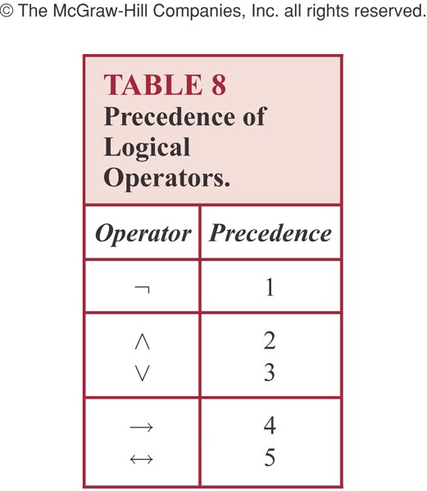
Precedence of Logical Operators
Parentheses get the highest precedence
Then ¬， ∧ ∨， → ↔
Examples:
p ∧ q ∨ r means (p ∧ q) ∨ r, not p ∧ (q ∨ r )
p ∨ (q → r) means (p ∨ q) → r
Notes:
逻辑运算优先级

Slide 30
Truth Table
Truth Table: visual display of the relationship between the truth values of propositions
Columns:
One column for each propositional variable
One column for each compound proposition
Rows:
Each row contains a possible configuration of truth values of variables and the results of compound propositions
For n propositional variables there will be 2^{n} rows

Slide 31
Truth Table
Solution:
p | q | r | p ∧ q | (p ∧ q) → r
T | T | T | T | T
T | T | F | T | F
T | F | T | F | T
T | F | F | F | T
F | T | T | F | T
F | T | F | F | T
F | F | T | F | T
F | F | F | F | T

Slide 32
Logic and Bit Operations
Bit: two possible values , 0 and 1
A Boolean variable is one whose value is either true or false.
A Boolean variable can be represented using a bit.
Bit operations correspond to logical operations of Boolean variables.
x | y | x ∨ y | x ∧ y | x ⊕ y
0 | 0 | 0 | 0 | 0
0 | 1 | 1 | 0 | 1
1 | 0 | 1 | 0 | 1
1 | 1 | 1 | 1 | 0
F→0 , T →1

Slide 33
Bitwise Operations
A bit string is a sequence of zero or more bits.
The length of this string is the number of bits in the string.
Bitwise operations are bit operations extended to bit strings.
Bitwise operations of two strings of the same length:
bitwise OR
bitwise AND
bitwise XOR

Slide 34
Bitwise Operations
Example: Find the bitwise OR, bitwise AND, and bitwise XOR of the bit strings 01 1011 0110 and 11 0001 1101.
01 1011 0110
11 0001 1101
11 1011 1111 bitwise OR
01 0001 0100 bitwise AND
10 1010 1011 birwise XOR

Slide 35
Applications of Propositional Logic
Section 1.2

Slide 36
Applications of Propositional Logic: Summary
Translating English to Propositional Logic
System Specifications
Boolean Searching
Logic Puzzles
Logic Circuits
AI Diagnosis Method (Optional)

Slide 37
Overview
Logic has many important applications to mathematics, computer science, and numerous other disciplines.
Statements in mathematics and the sciences and in natural language often are imprecise or ambiguous.
To make such statements precise, they can be translated into the language of logic.

Slide 38
Translating English sentences
Example: How can the following sentence be translated into a logical expression?
“You can access the Internet from campus only if you are a computer science major or you are not a freshman.”
Solution:
Let a: “you can access the Internet from campus,”
c: “you are a computer science major,”
f: “you are a freshman.”
This sentence can be represented as
a → (c ∨ ¬ f)

Slide 39
System Specifications
Example: Express in logical expression
“The automated reply cannot be sent when the file system is full.”
Solution:
Let p: “The automated reply can be sent”
q: “The file system is full”
This sentence can be represented as
q → ¬ p
Notes:
系统规范

Slide 40
Consistent System Specifications
【Definition】 A list of propositions is consistent if it is possible to assign truth values to the proposition variables so that each proposition is true.
Example: Are these specifications consistent?
“The diagnostic message is stored in the buffer or it is retransmitted.”
“The diagnostic message is not stored in the buffer.”
“If the diagnostic message is stored in the buffer, then it is retransmitted.”
Solution:
Let p: “The diagnostic message is stored in the buffer”
q: “The diagnostic message is retransmitted”
p ∨ q, ¬p , p→ q
When p is false and q is true all three statements are true. So the specification is consistent.
Notes:
一致

Slide 41
Logic Puzzles
Example: An island has two kinds of inhabitants, knights, who always tell the truth, and knaves, who always lie. You go to the island and meet A and B.
A says “B is a knight.”
B says “The two of us are of opposite types.”
What are the types of A and B?
Solution:
Let p: “A is a knight”
q: “B is a knight”
q, (p ∧ ¬ q)∨ (¬ p ∧ q)

Slide 42
Homework
Due date: Mar. 4 (Monday)
Sec. 1.1 2, 8(d, e), 16( e), 24, 30(b), 34(f), 52
Sec. 1.2 4, 10, 22

Slide 43
Chapter 1 The Foundations: Logic and Proofs
1.1 Propositional Logic
1.2 Applications of Propositional Logic
1.3 Propositional Equivalences
1.4 Predicates and Quantifiers
1.5 Nested Quantifiers
1.6 Rules of Inference
1.7 Introduction to Proofs
1.8 Proof Methods and Strategy

Slide 44
Classification of Compound Propositions
Tautology : compound proposition that is always true 永真式（重言式）
Contradiction : compound proposition that is always false. （矛盾）
Contingency: compound proposition that is neither a tautology nor a contradiction. （可能式）
Examples:
p ∧ ¬p
p ∨ ¬p
p ∨ ¬q
-- Contradiction
-- Tautology
-- Contingency

Slide 45
Logical Equivalences
【 Definition】The compound propositions p and q are called logically equivalent if p ↔ q is a tautology.
Notation: p ≡ q or p ⇔ q
Example: Show that ¬(p ∨ q) and ¬ p ∧ ¬q are logically equivalent.
Solution:
¬(p ∨ q) ≡ ¬ p ∧ ¬q
p | q | ¬ p | ¬ q | p ∨ q | ¬ (p∨q) | ¬ p∧¬q
T | T | F | F | T | F | F
T | F | F | T | T | F | F
F | T | T | F | T | F | F
F | F | T | T | F | T | T
De Morgan law

Slide 46
Logical Equivalences
Show p ≡ q
Using truth tables
Construct truth tables for p and q
Check the truth values of p and q to see if they agree
Using already-proved equivalences
Keep replacing a compound proposition with its equivalent proposition until achieving the goal
Easy but time-consuming when the number of variables is large
Just like what we do in Algebra

Slide 47
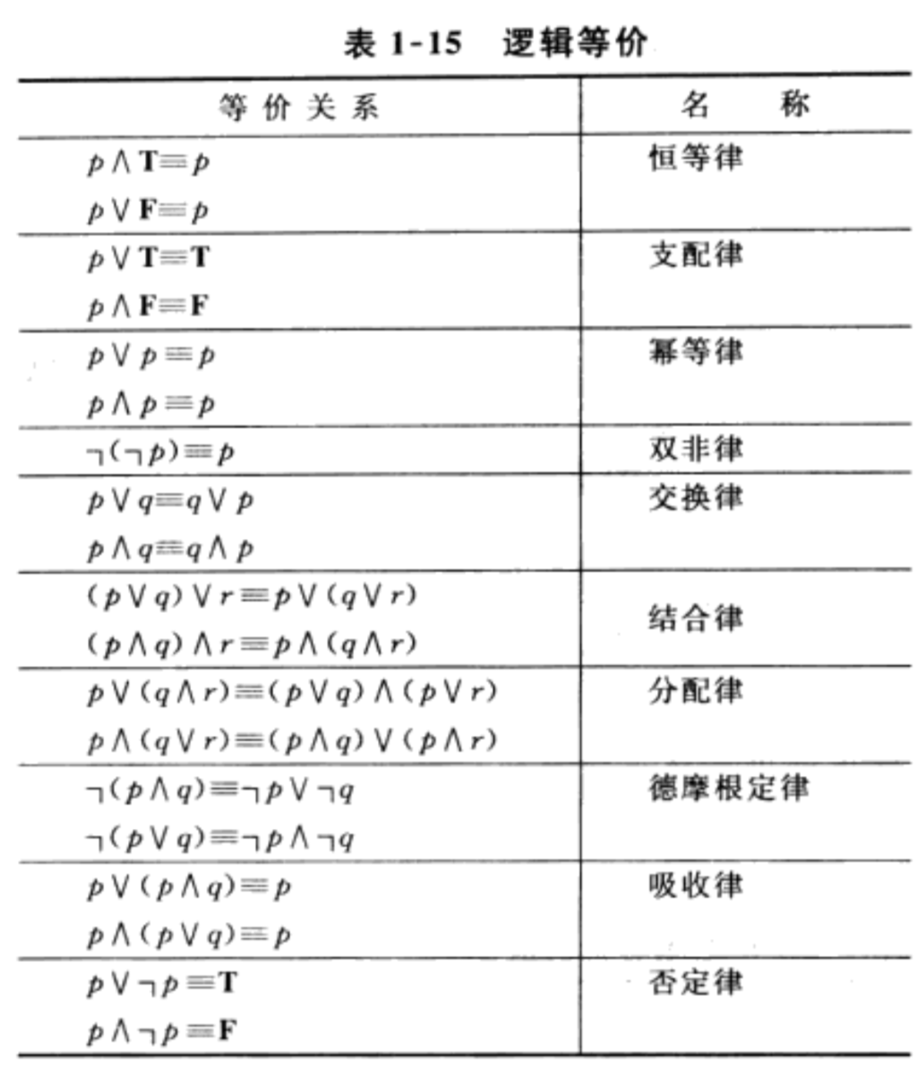
Logical Equivalences
Name | Equivalence
Identity laws | p ∧ T ≡ p p ∨ F ≡ p
Domination laws | p ∨ T≡ T p ∧ F ≡ F
Idempotent laws | p ∨ p ≡ p p ∧ p ≡ p
Double negation law | ¬(¬p) ≡ p
Commutative laws | p ∨ q ≡ q ∨ p p ∧ q ≡ q ∧ p
Associative laws | (p ∨ q) ∨ r ≡ p ∨ (q ∨ r) (p ∧ q) ∧ r ≡ p ∧ (q ∧ r)
Distributive laws | p ∨ (q ∧ r) ≡ (p ∨ q) ∧ (p ∨ r) p ∧ (q ∨ r) ≡ (p ∧ q) ∨ (p ∧ r)
De Morgan's laws | ¬(p ∧ q) ≡ ¬ p ∨ ¬ q ¬(p ∨ q) ≡ ¬ p ∧ ¬ q

Slide 48
Logical Equivalences
Name | Equivalence
Absorption laws | p∨ ( p ∧ q) ≡ p p ∧ ( p ∨ q) ≡ p
Negation laws | p ∨ ¬ p ≡ T p ∧ ¬ p ≡ F
Implication law | p → q ≡ ¬ p ∨ q
Equivalence law | p ↔ q ≡ (p → q) ∧ (q → p)

Slide 49
Logical Equivalences
Examples:
Show that ¬( p∨(¬ p ∧ q)) and ¬p ∧¬ q are logically equivalent.
Solution:
by the De Morgan’s law
by the De Morgan’s law
by the double negation law
by the distributive law
by the negation law
by the identity law

Slide 50
Logical Equivalences
Examples:
Show that is a tautology
Solution:

Slide 51
Logical Equivalences
Examples:
Show that and are not logically equivalent.
Hint:
To show these are not logically equivalent,
we need only find one assignment of truth values to p, q, r, s for which the truth values of the two propositions differ.

Slide 52
Using De Morgan’s Laws
Use De Morgan’s laws to express the negation of
“Mike has a cellphone and he has a laptop computer” and “Jim will go to the concert or Steve will go to the concert.”
Solution:
Mike does not have a cellphone or he does not have a laptop computer.
Jim will not go to the concert and Steve will not go to the concert.

Slide 53
Exercises
Find a compound proposition involving the propositional variables p, q, r that is true when exactly two of p, q, and r are true and is false otherwise.
p ∧ q ∧ ¬r
p ∧ ¬ q ∧ r
¬ p ∧ q ∧ r
Solution:
( p ∧ q ∧ ¬r ) ∨ (p ∧ ¬ q ∧ r ) ∨ (¬ p ∧ q ∧ r)

Slide 54
Exercises
The proposition p NOR q is true when both p and q are false, and it is false otherwise.
The operator ↓ is called Peirce arrow.
(a) show that p ↓ p is logically equivalent to ¬ p
(b) show that (p ↓ q) ↓ (p ↓ q) is logically equivalent to p ∨ q

Slide 55
Propositional Satisfiability
A compound proposition is satisfiable if there is an assignment of truth values to its variables that make it true.
When no such assignments exist, the compound proposition is unsatisfiable. （不可满足的）
A compound proposition is unsatisfiable if and only if its negation is a tautology.
Examples:

Slide 56
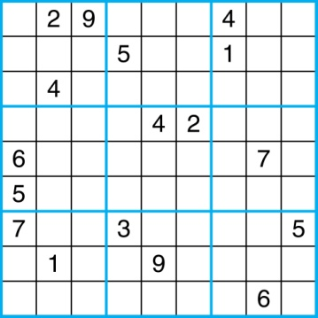
Sudoku
A Sudoku puzzle is represented by a 9×9 grid made up of nine 3×3 subgrids, known as blocks. Some of the 81 cells of the puzzle are assigned one of the numbers 1,2, …, 9.
The puzzle is solved by assigning numbers to each blank cell so that every row, column and block contains each of the nine possible numbers.

Slide 57
Encoding as a Satisfiability Problem
Let p(i, j, n) denote the proposition that is true when the number n is in the cell in the ith row and the jth column.
There are 9×9 × 9 = 729 such propositions.
In the sample puzzle, p(5,1,6) is true, but p(5, j, 6) is false for j = 2,3,…9

Slide 58
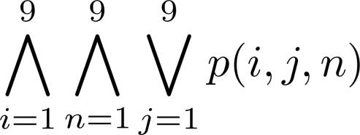
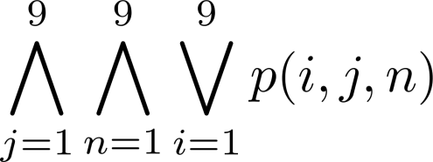
Encoding as a Satisfiability Problem
For each cell with a given value, assert p(d, j, n), when the cell in row i and column j has the given value.
Assert that every row contains every number.
Assert that every column contains every number.

Slide 59
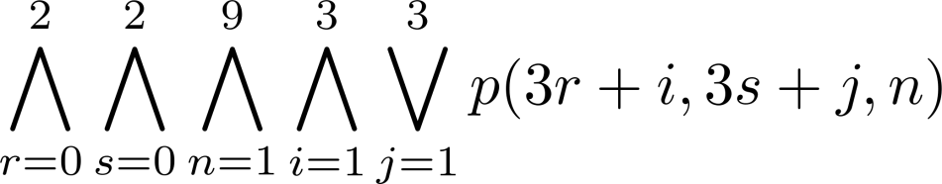
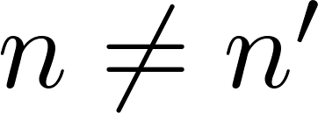
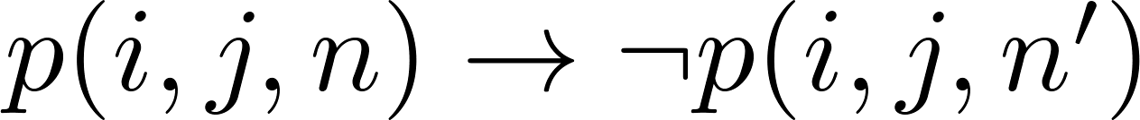
Encoding as a Satisfiability Problem
Assert that each of the 3 x 3 blocks contain every number.
Assert that no cell contains more than one number. Take the conjunction over all values of n, n’, i, and j, where each variable ranges from 1 to 9 and , of
Find an assignment of truth values to the 729 variables of the form p(i, j, n) that makes the conjunction of the above assertions true. Those variables that are assigned T yield a solution to the puzzle.
Curse of Dimensionality

Slide 60
Homework
Due date: Mar 4 (Monday)
Sec. 1.3 6, 8(a,b), 14(b), 34, 36, 44, 55

